Slide 1
Exam 1 Review

Slide 2
Topics For Exam 1
Topics | Reading
Introduction | 1.1-1.3
Induction and Loop invariants | 1.4-1.7, GT 1.3
Elementary Algorithmics | Chapter 2
Asymptotic Notation | Chapter 3
Algorithm Analysis - Analyzing control structures - Worst-case and Average-case - Amortized analysis | 4.1-4.6
Solving Recurrences | 4.7
Exam 1

Slide 3
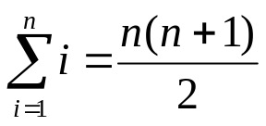
Induction Proof
Mastering
  First and second principles of induction
  Given a mathematical equation, know how to prove it by induction
    Example: prove by induction that
Exposure
  Constructive induction

Slide 4
Invariant
To prove some statement S about a loop is correct, define in terms
of a series of smaller statement S₀, S₁ …, S_{k} where:
The initial claim, S₀, is true before the loop begins.
If S_{i-1} is true before iteration i begins, then one can show that S_{i} will be true after iteration i is over or at the beginning of loop i+1.
The final statement, S_{k}, implies the statement S that we wish to justify as being true.
This is essentially an induction proof. The proof is for a loop iterating from 1 to k. It's trivial to expand this argument to other loop bounds.

Slide 5
Loop Invariant: Example
Prove the following loop find the max(a[0], …, a[n-1])
int max(int a[n])
{
int max = a[0];
int i;
for (i=1; i<=n-1; i++)
if (max < a[i])
max = a[i];
return max;
}

Slide 6
Elementary Algorithmics
Given a problem
  What’s an instance
  Instance size
What does efficiency mean?
  Time

Slide 7
Average and worst-case analysis
How to compare two algorithms
  Worst case, average, best-case
Worst case
  Appropriate for an algorithm whose response time is critical
Average
  For an algorithm which is to be used many times on many different instances
  Harder to analyze, need to know the distribution of the instances
Best case

Slide 8
Elementary Operation
An elementary operation is one whose execution time can be bounded above by a constant depending only on the particular implementation—the machine, the programming language, etc.
Example
  X = Sum{A[i] | 1 <= i <= n}
  Fibonacci sequence, addition may not be an elementary operation

Slide 9
Asymptotic Notation
What does “the order of” mean
Big O, Ω, and Θ notations
Properties of asymptotic notation
Limit rule
Duality rule
Smooth and b-smooth

Slide 10
Asymptotic notations
Know the definitions of big O, Ω, and Θ notations
  Example: what does O(n²) mean?
Know how to prove whether a function is in big O, Ω, or Θ based on definition
  Example
    Prove that if f(n)  O(g(n)) then g(n)  Ω(f(n))

Slide 11
Maximum, Duality and Limit rules
Know to prove asymptotic relationship using the rules
  Example
    Show that O((n+1)²) = O(n²)

Slide 12
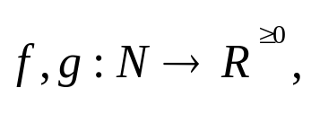
The Maximum rule
Let
then
Examples
  O(12n³-5n+nlogn+36) = O(n³)
The maximum rule let us ignore lower-order terms

Slide 13


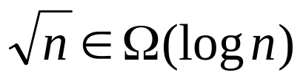
The Duality Rule
iff
Example:
We can apply, similarly, the limit rule, the maximum rule,
and the threshold rule for Ω using the duality rule

Slide 14
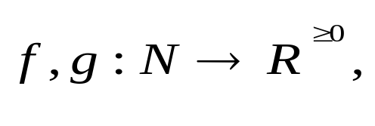
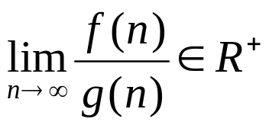


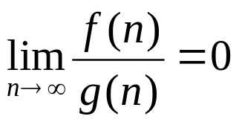

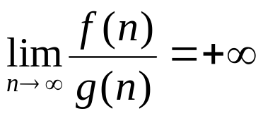

The Limit Rule
Let then
If then and
If then and
If then and
Proof: use the definition of limit and big-O

Slide 15
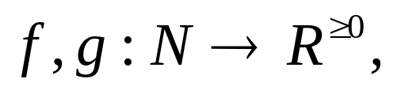



The Limit Rule
Let then
If then
If then but
If then but

Slide 16
Semantics of big-O and Ω
When we say an algorithm takes worst-case time
t(n)  O(f(n)), then there exist a real constant c such that c*f(n) is an upper bound for any instances of size of sufficiently large n
When we say an algorithm takes worst-case time
t(n)  Ω(f(n)), then there exist a real constant d such that there exists at least one instance of size n whose execution time >= d*f(n), for any sufficiently large n
Example
  Is it possible an algorithm takes worst-case time O(n) and Ω(nlog n)?

Slide 17
Practice Problems
True or false
  The algorithm takes time in O(n²) F
  The algorithm takes time in Ω(n²) T
  The algorithm takes time in O(n³) T
  The algorithm takes time in Ω(n³) F
  The algorithm takes time in Θ(n³) F
  The algorithm takes time in Θ(n²) F
  The algorithm takes worst case time in O(n³) T
  The algorithm takes worst case time in Ω(n³) T
  The algorithm takes worst case time in Θ(n³) T
  The algorithm takes best case time in Ω(n³) F
anAlgorithm( int n)
{
// if (x) is an elementary
// operation
if (x) {
some work done
by n² elementary
operations;
} else {
some work done
by n³ elementary
operations;
}
}

Slide 18




Smooth
Know the definition of smooth and how to prove if a function is smooth or not
  Example: what does b-smooth mean?
  Prove that n² is smooth
A function is eventually nondecreasing if there exists an integer threshold
such that for all
Function f is b-smooth ( b is an integer >1) if it is eventually nondecreasing and it satisfies condition
f(bn)  O(f(n))
A function is smooth if it is b-smooth for every integer b>=2
Theorem: If a function is b-smooth for any b>=2, it is smooth

Slide 19




Exposure: Smoothness rule
Let be a smooth function and
let be an eventually nondecreasing function. Then whenever
is power of b)
The rule holds for O and Ω

Slide 20
Analysis of Algorithms
Mastering
  Analyzing control structures
      Sequencing
      For loops
      While and repeat loops
      Recursive calls
  Finding and using a barometer
  Average case analysis
Exposure
  Amortized analysis

Slide 21
Control structures: sequences
P is an algorithm that consists of two fragments, P1 and P2
P1 takes time t1 and P2 takes times t2
The sequencing rule asserts P takes time
t=t1+t2  Θ(max(t1,t2)).
P
{
P1;
P2;
}

Slide 22
Control structures: sequences
P is an algorithm that consists of two fragments, P1 and P2
P1 takes time t1 and P2 takes times t2
The sequencing rule asserts P takes time
t=t1+t2  Θ(max(t1,t2)).
P
{
P1;
P2;
}

Slide 23
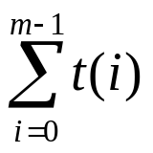
For loops
Case 1: P(i) takes time t independent of i and n, then the loop takes time O(mt) if m>0.
Case 2: P(i) takes time t(i), the loop takes time
for (i=0; i<m; i++) {
P(i);
}

Slide 24
Example: analyzing the following nests
for (i=0; i<n; i++) {
for (j=0; j<n; j++)
constant work
}
for (i=1; i<n; i++) {
for (j=0; j<i; j++)
constant work
}
for (i=1; i<n; i++) {
for (j=0; j<i*i; j++)
constant work
}
for (i=1; i<n; i++) {
for (j=0; j<i; j++)
constant work
for (k=0; k<i*i; k++)
constant work
}

Slide 25
“while” and “repeat” loops
The bounds may not be explicit as in the for loops
Careful about the inner loops
  Is it a function of the variables in outer loops?
Analyze the following two algorithms
int example1(int n)
{
while (n>0) {
work in constant;
n = n/3;
}
}
int example2(int n)
{
while (n>0) {
for (i=0; i<n; i++) {
work in constant;
}
n = n/3;
}
}

Slide 26
Recursive calls
Typically we can come out a recurrence equation to mimics
the control flow.
double fibRecursive(int n)
{
double ret;
if (n<2)
ret = (double)n;
else
ret = fibRecursive(n-1)+fibRecursive(n-2);
return ret;
}
a if n = 0 or 1
T(n-1)+T(n-2)+h(n) otherwise
T(n) =

Slide 27
Using a Barometer
A barometer instruction is one that is executed at least as often as any other instruction in the algorithm
We can then count the number of times that the barometer instruction get executed
  Provided that the time taken by each instruction is bounded by a constant, the time taken by the entire algorithm is in the exact order of the number of times the barometer instruction is executed

Slide 28
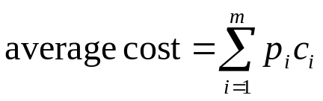
Average Case Analysis
We need to know instance distribution
  Given the instance distribution, know how to calculate the average cost
Sometimes we make ideal assumption that all instances of any given sizes are equally distributed

